Slide 1

Writing your first
Smart Contract
Advanced Move concepts, Sui-specific features, framework integration, and practical projects

Slide 2
Agenda
Advanced Move Concepts for Sui
Testing and Verification & Gas Optimization
Shared Objects, Dynamic Fields
Clock Object and Time, Decentralized Governance
Integration with Sui Framework and Libraries
Practical Exercises

Slide 3
Advanced Move Concepts
Concept
Description
Relevance to Advanced Objects
Object-Centric Global Storage
Sui eliminates global storage, using objects with unique IDs for scalability and parallel processing
Central to Sui’s architecture replacing traditional storage models
Addresses and Object IDs
Objects and accounts use 32-byte identifiers, with objects storing IDs in id:UID field
Ensure unique addressing, crucial for object management
Object with Key Ability
Requires key ability, with id:UID as the first field, enforced by bytecode verifier
Defines objects as first-class entities on-chain
Module Initializers
Special function run once at publication for setting up module-specific data, e.g., singleton objects
Facilitates initial object setup in smart contracts
Entry Functions
Callable in PTBs, used for atomic operations like on-chain randomness, with specific input restrictions
Enhances object interaction in complex transactions
Ownership Models
Includes exclusive (owner-only mutation), shared (anyone can mutate, needs consensus), and immutable (cannot change)
Critical for controlling object access and security
Dynamic Fields
Allow adding/removing fields at runtime, enabling flexible data structures
Advanced feature for extensible object design

Slide 4
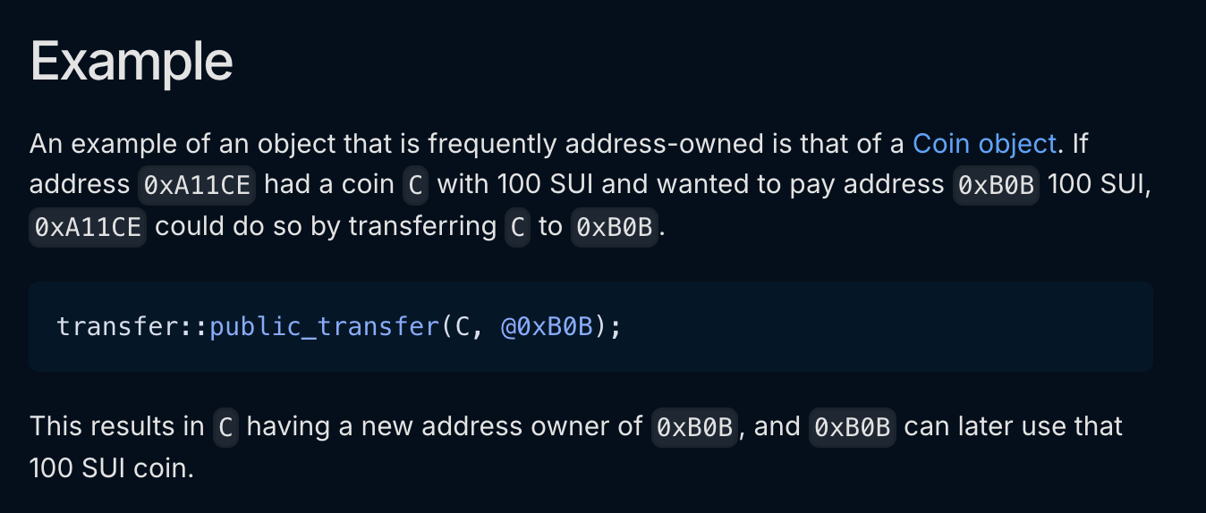
Ownership Models
Details exclusive ownership (owner-only mutation), shared objects (mutable by anyone, requires consensus), and immutable objects (cannot change, used for packages).
Link: https://docs.sui.io/concepts/object-model

Slide 5
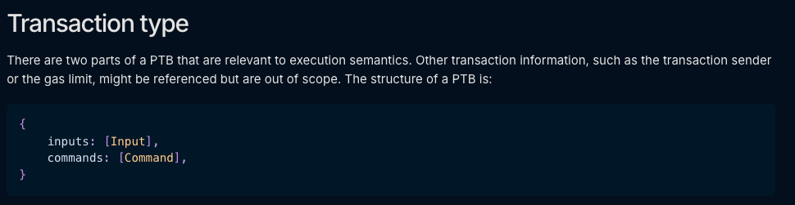
Advanced Features: PTBs
The inputs value is a vector of arguments
The commands value is a vector of commands, and the possible commands are: TransferObjects, SplitCoins, MakeMoveVec, …
https://docs.sui.io/concepts/transactions/prog-txn-blocks

Slide 6
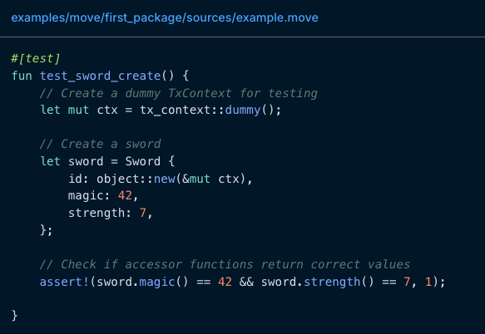
Testing, Verification & Gas Optimization
Testing
Write unit tests using #[test] attribute to ensure correctness.
Example: assert!(2 + 2 == 4);
Using SUI to command to run test:
sui move test
=> Testing guide | Sample Code

Slide 7
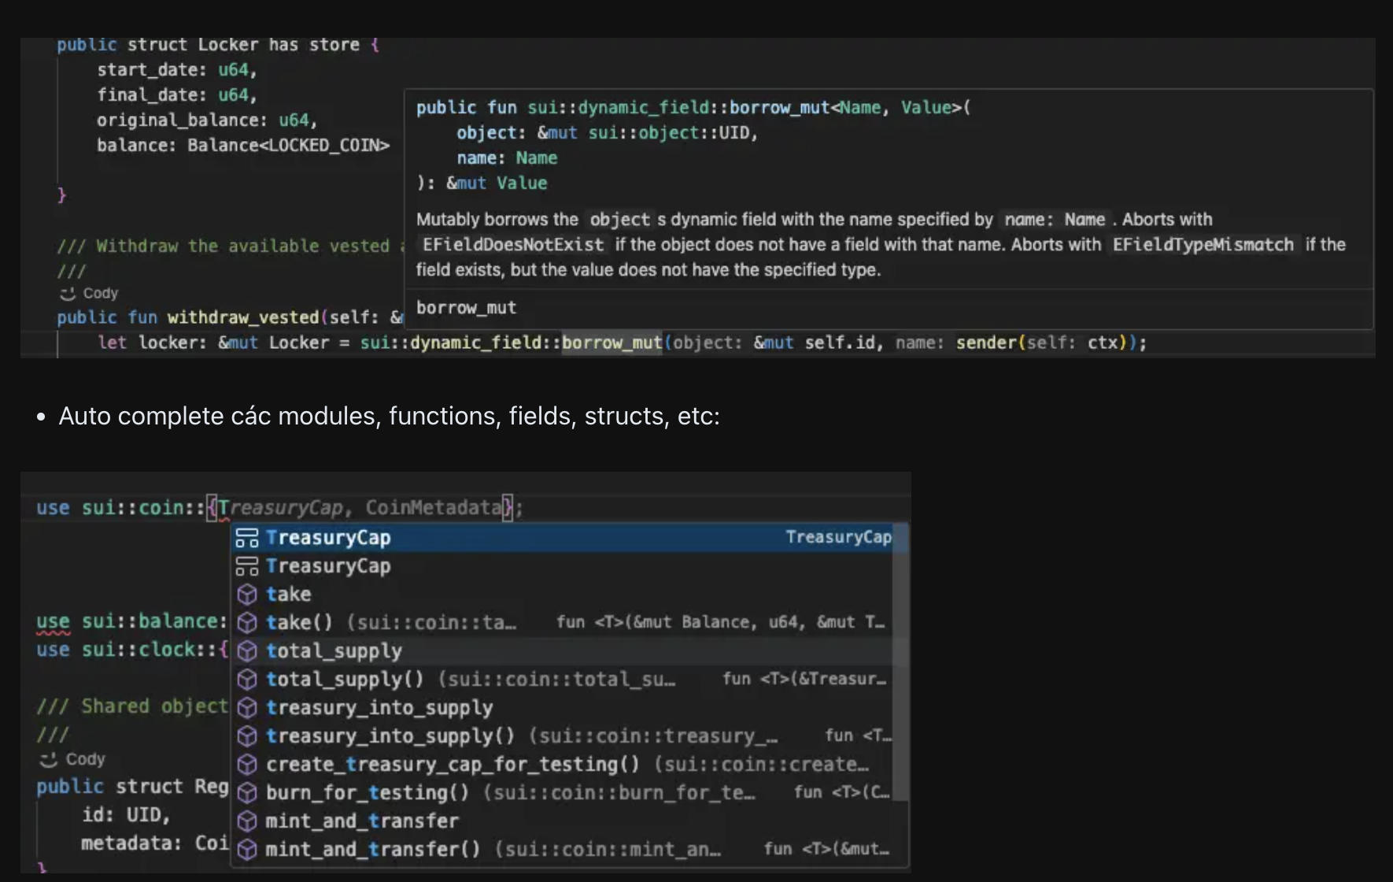
Testing, Verification & Gas Optimization
Verification
Use Move Prover for formal verification of smart contracts.
*Example: Prove functions abort under specific conditions.
Sui-move-analyzer

Slide 8
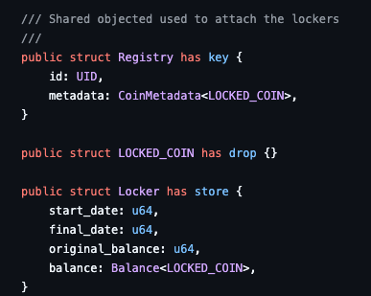
Testing, Verification & Gas Optimization
Gas Optimization
Minimize gas costs by reducing storage usage and computation.
Verify gas budget for smart contract function:
https://docs.sui.io/concepts/tokenomics/gas-in-sui
=> Sui Gas Model

Slide 9
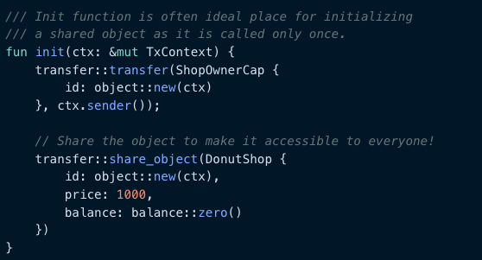
Shared Objects, Dynamic Fields
Shared Objects
Objects accessible and mutable by multiple parties for collaboration.
*Example: Shared object in a decentralized exchange (DEX).
https://docs.sui.io/concepts/object-ownership/shared

Slide 10
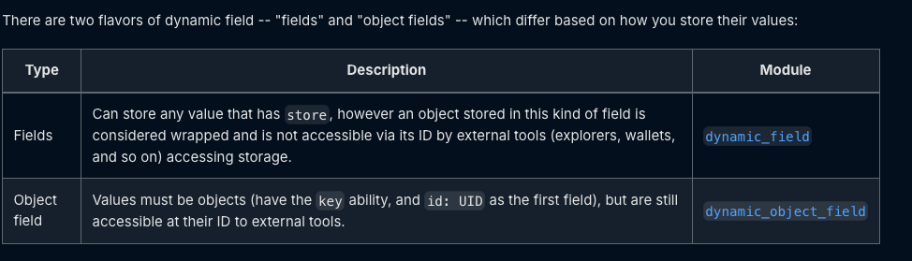
Shared Objects, Dynamic Fields
Dynamic Fields
Add fields to objects at runtime for flexible data structures.
*Example: Dynamically adding metadata to NFTs.
https://docs.sui.io/concepts/dynamic-fields

Slide 11

Clock Object and Time, Decentralized Governance
Clock Object and Time
Access on-chain time for time-based smart contract logic.
*Example: Use sui::clock::timestamp_ms for vesting schedules.
Decentralized Governance
Implement governance using capabilities and shared objects.
*Example: Voting on protocol upgrades via SIPs (Sui Improvement Proposals).
Time access | SIPs repository

Slide 12
Integration with Sui Framework and Libraries
Sui Framework
Libraries
Use standard Sui modules for streamlined development.
*Example: sui::coin for custom token implementations.
Explore standard libraries for common functionalities.
*Example: sui::vector for dynamic arrays.
Learn more
Learn more

Slide 13
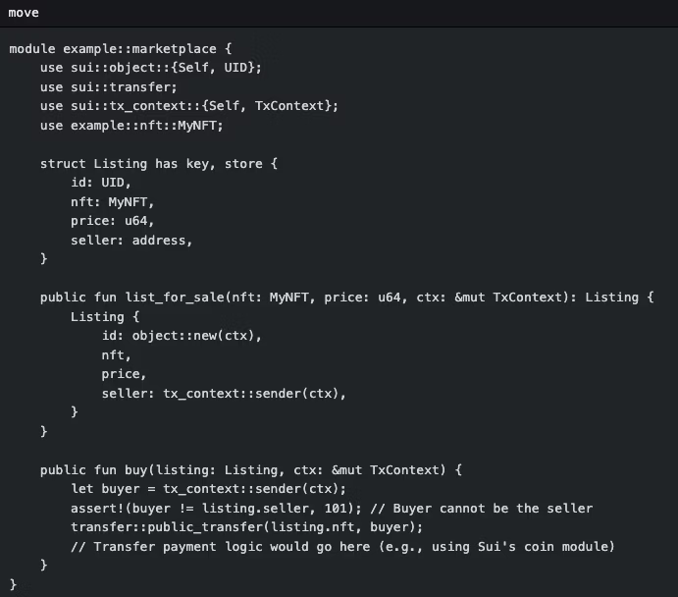
Practical Exercises
Creating an NFT
Define an NFT struct with metadata like name and description.
Marketplace Logic
Functions for listing NFTs and enabling purchases using Listing resources.

Slide 14
Thank You.

